Slide 1
The Cherab Foundation
a 501(c)3 nonprofit
Help bring our cherubs a smile and a voice

Slide 2
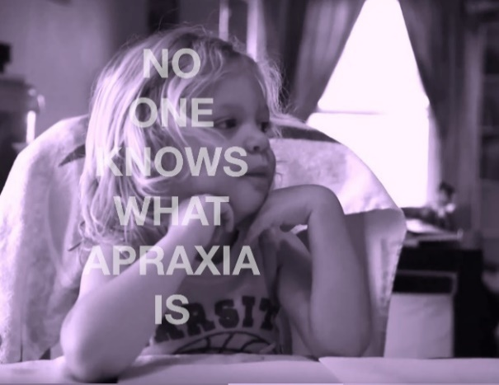
Our Mission
The Cherab Foundation is a world-wide nonprofit organization working to improve the communication skills and education of all children with speech and language delays and disorders. Our area of emphasis is verbal and oral apraxia, severe neurologically-based speech and language disorders that hinder children’s ability to speak.
The Cherab Foundation is committed to assisting with the development of new therapeutic approaches, preventions and cures for neurologically-based speech disorders. We bring together parents and medical, research, and educational professionals.

Slide 3
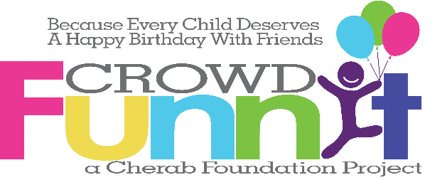
Our Projects
Nutritional Strategies
Research
Community of Support
Anti-bullying Campaign
Books
Films
Web

Slide 4
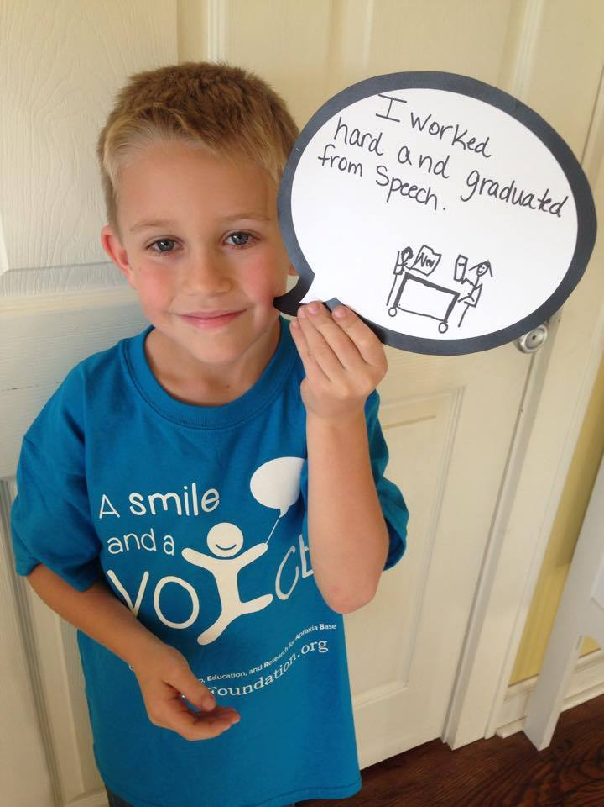
Nutritional Strategies
Pursuit of Research strives to promote good nutrition from foods that provide essential nutrients, with an emphasis on functional foods for those individuals with neurologically based impairments and conditions. Most don’t appreciate the evidence between nutrition and cognition, and the gut/brain connection. Food changes gut bacteria in as quick as one day.
The primary function of Pursuit of Research is to share healthy nutritional strategies for those with special needs and to provide hope and education.
Pursuit of Research works with the CHERAB Foundation to improve the communication skills, education, and advocacy of the verbally disabled, while also researching into the nutritional options that directly impact the lives of those affected.

Slide 5
Research
There is very little research done for Apraxia, and despite numerous studies on Autism, the evidence for most strategies studied is weak, and in some cases, (particularly with medication) potentially dangerous due to side effects according to a ten year meta analysis published in the journal Pediatrics. Families typically have to endure many years of multiple therapies which are both costly and time consuming for painfully slow progress, if any. The financial and emotional strain on families who have a special needs child can be overwhelming.
The Cherab Foundation has been sharing simple, healthy, benign nutritional strategies as a compliment to traditional speech and occupational therapies for over a decade. We have completed some pre-clinical research, and now need to embark on a double blind pilot study with these strategies. We currently have a proposal to complete this study. When validated this strategy will help raise awareness about Apraxia, Autism and other Neurologically based Communication Disorders, as well as provide a proven strategy that can be made available to the public.
pursuitofresearch.org

Slide 6
As A Group We Are Finding Strategies That Work

Slide 7
How Can You Help?
Corporate Sponsorship Of Our Various Projects
Development Partners
Research Partners
Strategic Alliances

Slide 8
Community Of Support
cherabfoundation.org

Slide 9
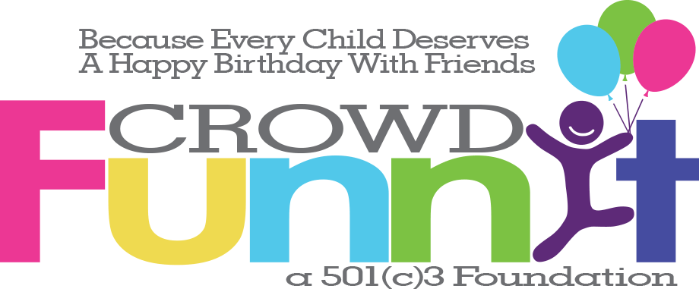
Anti-Bullying Campaign
crowdfunnit.org
At the core crowdFunnit brings people together, raising awareness about differences while fostering acceptance and compassion. Helping a friendless child celebrate a birthday is just an incredible mechanism in which to help make this happen. The party itself and any media attention it brings will help fight bullying at the root while the community connections will exist long after the party ends.

Slide 10
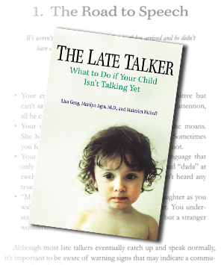
Books
The Late Talker What to do if Your Child isn’t Talking Yet
by Marilyn Agin MD, Lisa Geng, and Malcolm J. Nicholl
St Martin’s Press
The first book to show parents how to tell whether a child has a speech delay or a more serious communication disorder.
Every parent eagerly awaits the day his or her child will speak for the fist time. For millions of mothers and fathers, however, anticipation turns to anxiety when those initial, all-important words are a long time coming. Many worried parents are reassured that their child is “just a late talker,” but unfortunately, that is not always the case. Co-author Lisa Geng was one of those parents and she discovered that her children had serious speech disorders.
Coming Soon:
The Late Talker Grows Up

Slide 11
Films
Late Talkers, Silent Voices is a multimedia project by an award winning producer along with talented media and nonprofit professionals designed to foster acceptance, share personal stories and provide resources to individuals and families impacted by communication disorders. We believe all have a right to be heard and understood. Our first documentary tells the story of 5 individuals, ages 3-19, whose lives are impacted by autism, apraxia, and stuttering.
We are currently funding further documentary films featuring other families as well as professionals including special education teacher Chris Ulmer, creator of Special Books for Special Kids.
latetalkersfilm.com

Slide 12
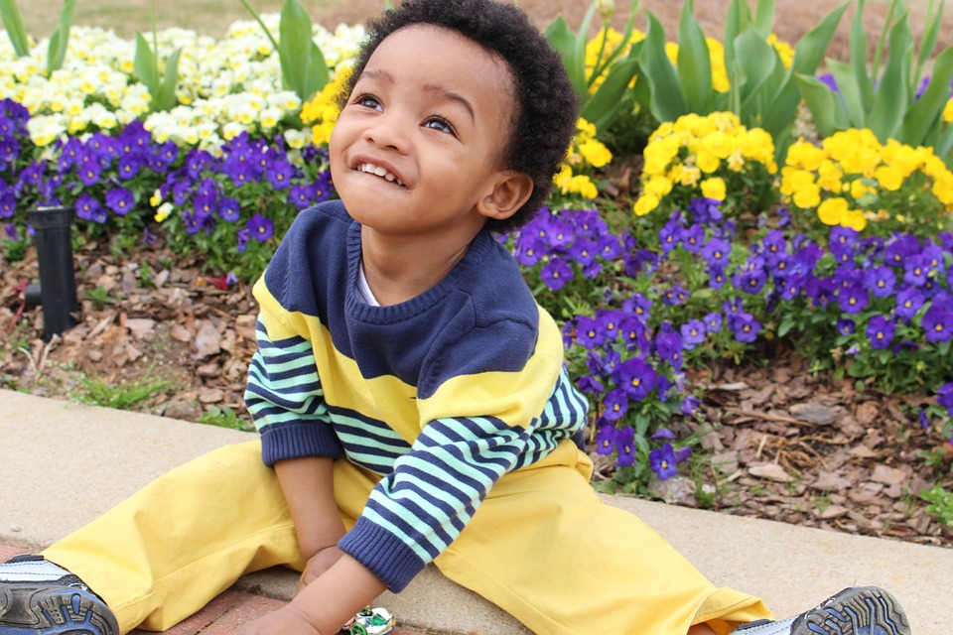
Multi-Media
“I may not talk but I have so much to say. I speak with my hands, my eyes, my hugs, my tears, my giggles, my iPad.”
This is a critical time: Diagnosis and treatment for communications disorders is still evolving while the population with speech and language disorders is increasing. By raising awareness, Late Talkers, Silent Voices advocates for protection and acceptance of these children and offers state-of-the-art resources and research to families looking for solutions. Late Talkers, Silent Voices reflects the belief that while prognosis for every child is different, with appropriate diagnosis and therapy, every child has the ability to achieve his or her full potential.
We are seeking funding for the following:
Finishing funds for our current, documentary short.
Funding further documentary films featuring other families as well as professionals including special education teacher Chris Ulmer, creator of Special Books for Special Kids.
An interactive website presenting up-to-date information for the special needs community in a variety of platforms – organized by region, by diagnosis, and by specialist – answering questions, pooling resources and creating a worldwide community of support and activism.

Slide 13
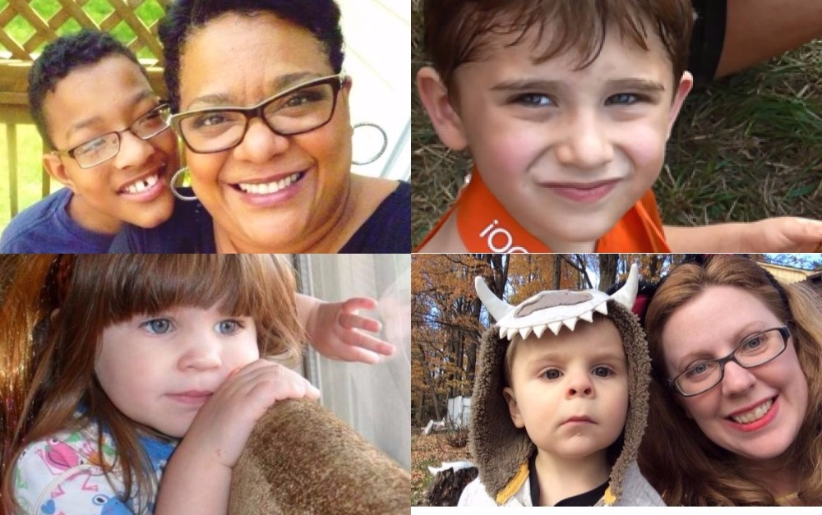
Eyes, Hands, Tears, Laughter And Hugs Tell Their Stories. With Your Support They Could Say So Much More.

